Slide 1

Project Pitch
V-OAR
The INT-stigators

Slide 2

Our Team
James Farrell
Team Lead [Main]
VR Development
Multiplayer
Git Master
Kristine Saroka
Level Scripting [Main]
Testing
Game Physics
Keelan Murphy
3D Modelling [Main]
3D Animation
Level Design
Concept Art
Nathan Hill
Scrum Master [Main]
Texture Designer
UI Designer

Slide 3
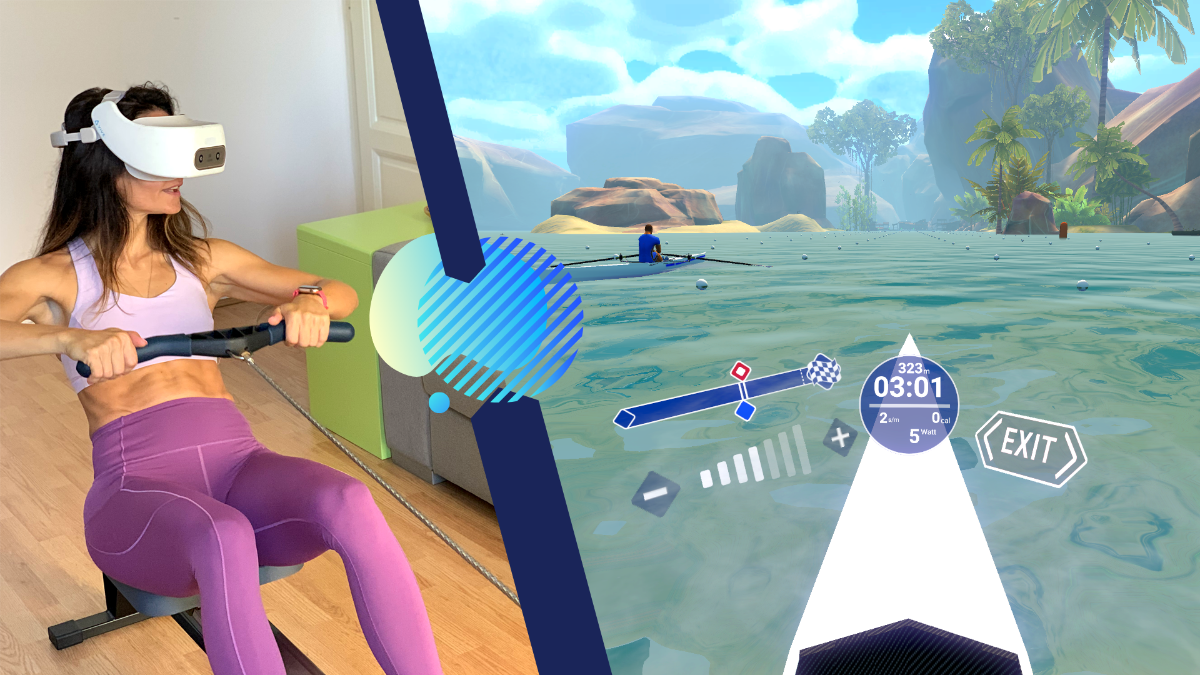
V-OAR is a virtual reality rowing experience, which transforms a typical workout into explorations of an open world
Game Idea
Combining virtual gameplay with physical interactions

Slide 4

Primary Target Group
Frequent and experienced rowers, who are typically part of a club or team.
Demographic
Objective
Provide an alternative for rowers who are unable to row due to external factors – such as poor weather, lack of access to equipment, injuries or ailments, and unprecedented global pandemics. We also hope to improve their existing experience by providing them with a training solution.

Slide 5

Game
Controls
VR Attachment
Rowing Machine
Resistance Band
Resistance Bands
To avoid making the game too exclusive, the resistance band would be a good alternative to the rowing machine, which would be much easier to obtain within the average household.

Slide 6
Game
Demo
Singleplayer
Multiplayer

Slide 7
Game
Demo
Singleplayer
Multiplayer

Slide 8
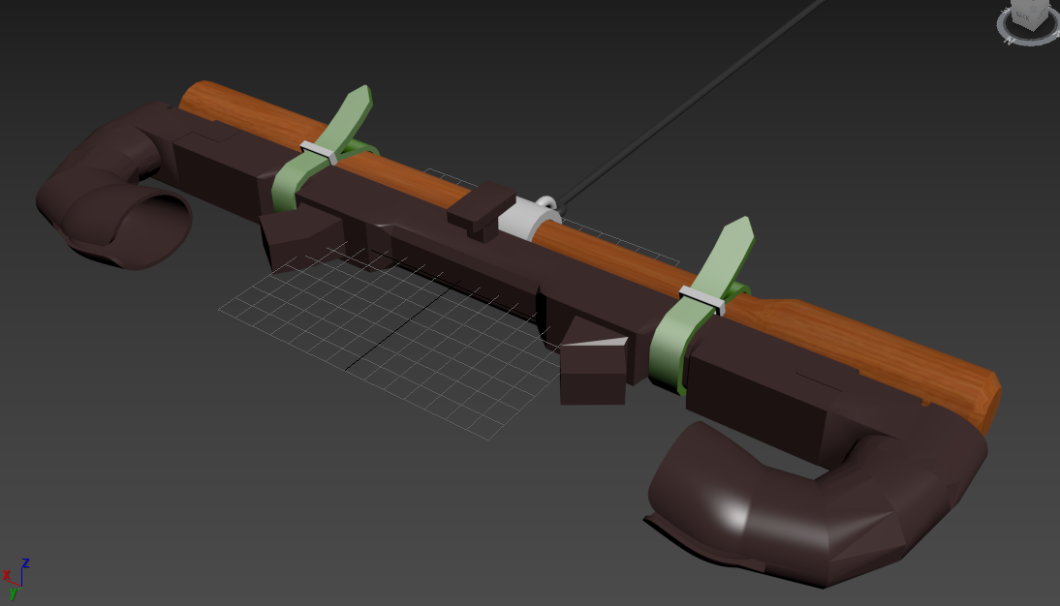
VR Attachment
Attachment designed for holding the set of VR controllers angled in a specific way to help the user hold the controllers and aid them in their movements.
Game
Demo
VR Attachment
Rowing Machine
Resistance Band
Description
The attachment will contain a set of straps for harnessing it atop a rowing machine handle and a hook for securing bands or ropes.

Slide 9
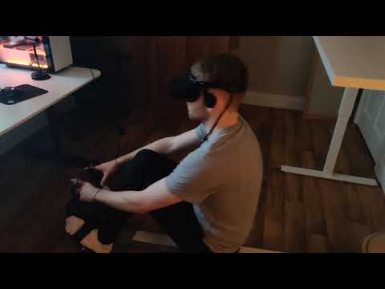
Game
Controls
VR Attachment
Rowing Machine
Resistance Band
Rowing Machine
Initially, rowing machine users were our primary target that bared life to this game's idea. Despite our demographic taking a change to include a larger audience. The rowing machine remains as a feasible and compatible device to playing this game.

Slide 10
Survey Results
Survey results allowed us to rank our game features in order of importance to users:
Realistic Rowing Techniques | 8.6
Stats | 8.5
Realistic Boat Movements | 7.8
Multiplayer | 7.2
Race | 7
Training | 7
Realistic Wind & Water Physics | 7
Exploratory | 6.5
Achievements | 6
Boat Customisation | 5.7
Character Customisation | 4.5
User
Feedback
Quantitative
Qualitative

Slide 11
Survey Results
Qualitative feedback from our users suggests:
XYZ | 8.6
Stats | 8.5
Realistic Boat Movements | 7.8
Multiplayer | 7.2
Race | 7
Training | 7
Realistic Wind & Water Physics | 7
Exploratory | 6.5
Achievements | 6
Boat Customisation | 5.7
Character Customisation | 4.5
User
Feedback
Quantitative
Qualitative

Slide 12


Visuals

